Slide 1
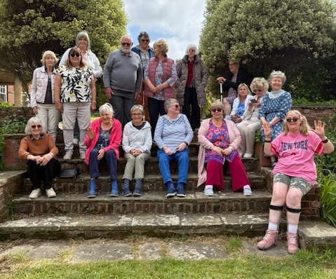
HBC is a very friendly and welcoming village church. They are an older congregation focused on outreach to their demographic, who are known for their friendliness. This is seen in their small groups, alongside prayer, fellowship and bible study.
Their primary outreach is their friendship and lunch club, where most attendees are not from the church. They are also reaching out in new ways by participating in village events and renting their hall. Alongside this, they collect for the food bank, and they create a phenomenal 500 shoeboxes each year for the annual appeal.
P
Prayer Focus: Holland-on-Sea Baptist Church

Slide 2
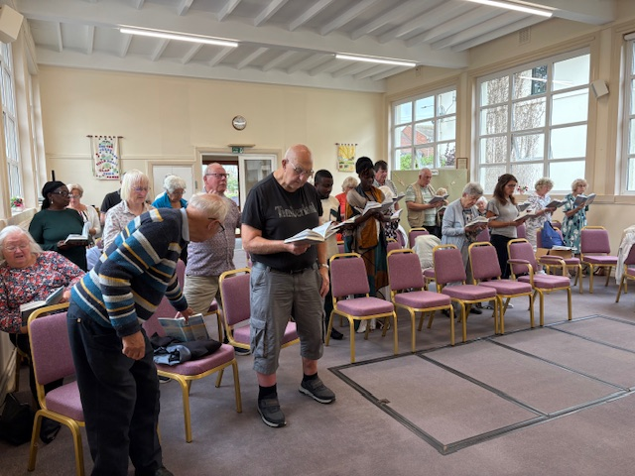
P
Prayer Focus: Holland-on-Sea Baptist Church
Earlier this year, their Minister retired, and whilst not rushing the process, the diaconate are keen to find the new minister that God is calling to them.
Please pray with them:
• For the church profile to reflect their church now, and as God plans it to be, and for any potential new ministers.
• For those who use the church hall, that they may be blessed and encounter God.
• For all those they meet during outreach.
• For the church and their ongoing efforts to create shoeboxes.

