Slide 1
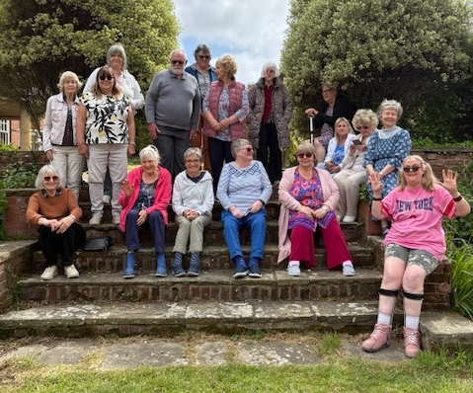
Holland-on-Sea Baptist Church is a very friendly and welcoming village church. They are an older congregation focused on outreach to their demographic. All who join the church say they were welcomed straight away, and they are known for their friendliness within the village. This is seen in their small groups, where they pray for one another, alongside fellowship and bible study.
Their primary outreach is their friendship club and lunch club, where most attendees are not from the church. They are also reaching out in new ways by participating in village events. They also rent their hall to many groups, providing access to their information and visible bible verses. Alongside this, they collect for the food bank, and they create a phenomenal 500 shoeboxes each year for the annual appeal.
Prayer Focus: Holland-on-Sea Baptist Church

Slide 2
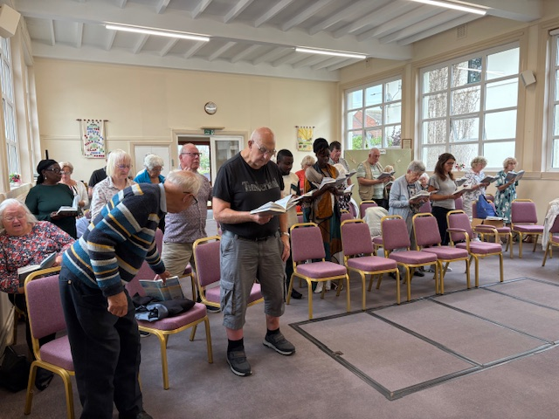
Earlier this year, their Minister retired, and their diaconate, who are a mix of newly appointed and experienced deacons, who, with the aid of a great moderator, are looking to the future. Whilst not rushing the process, they are keen to find the new minister that God is calling to them.
Please pray with them:
• For the church profile to reflect their church now, and as God plans it to be, and for any potential new ministers.
• For those who use the church hall, that they may be blessed and encounter God.
• For all those they meet during outreach.
• For the church and their ongoing efforts to create shoeboxes.
Prayer Focus: Holland-on-Sea Baptist Church

