Slide 1
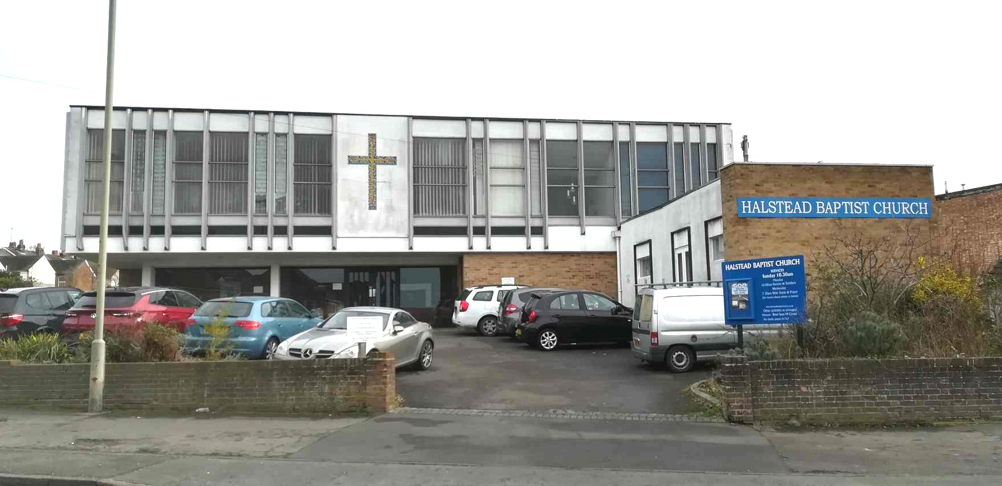
Halstead Baptist Church is situated a short distance from the High Street. Halstead is a picturesque dormitory town, with many residents travelling for employment. The fellowship at Halstead is currently in a period of ministerial vacancy. They are well supported by visiting preachers each Sunday and by Rev. Ellie Ake, the Moderator. Members of the congregation meet mid-week for bible study, fellowship and prayer. The church owns a charity shop on Halstead High Street. Despite the fellowship being small in number, they open three days per week. The shop provides good opportunities for outreach.
P
Prayer Focus: Halstead Baptist Church

Slide 2
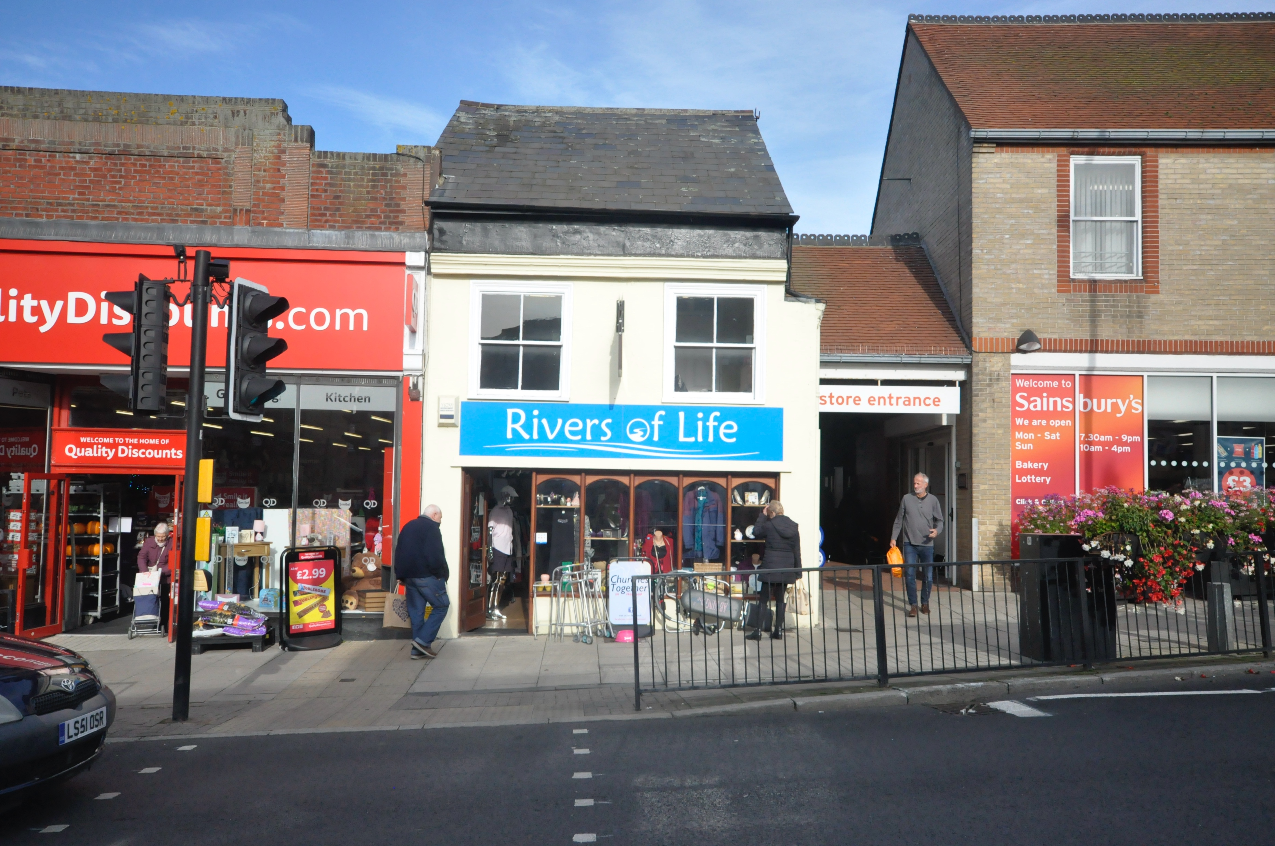
Halstead Baptist Church is thankful for God’s provision enabling them to continue in spite of the prevailing difficult economic situation and high maintenance costs. Please pray for • New relationships that will produce fruit for the Kingdom • New people to come alongside and support the fellowship • Perseverance and wisdom for the days ahead and that God’s vision for the future of the Church will become clear.
P
Prayer Focus: Halstead Baptist Church

