Slide 1
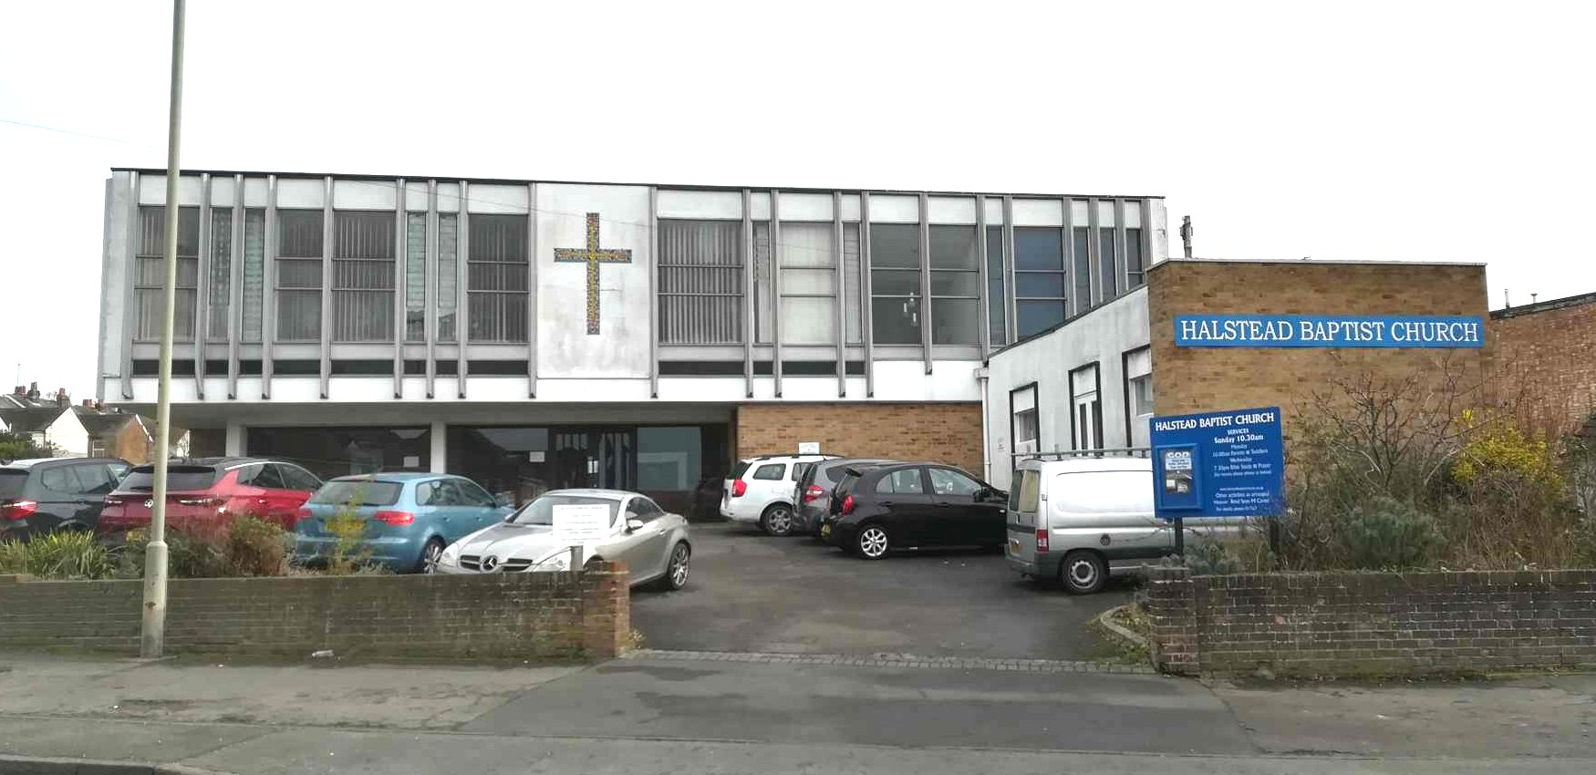
Halstead Baptist Church is situated in the picturesque town of Halstead, a short distance from the High Street. Halstead is a dormitory town, with many residents travelling considerable distances for employment. There are several primary schools and a comprehensive secondary school.
The fellowship at Halstead is currently in a period of ministerial vacancy. Their previous Minister having been called to a new church at the beginning of 2024. They are well supported by visiting preachers each Sunday and by Rev. Ellie Ake, the Moderator, who is offering guidance and encouragement.
Members of the congregation meet mid-week for bible study, fellowship and prayer.
Prayer Focus: Halstead Baptist Church

Slide 2
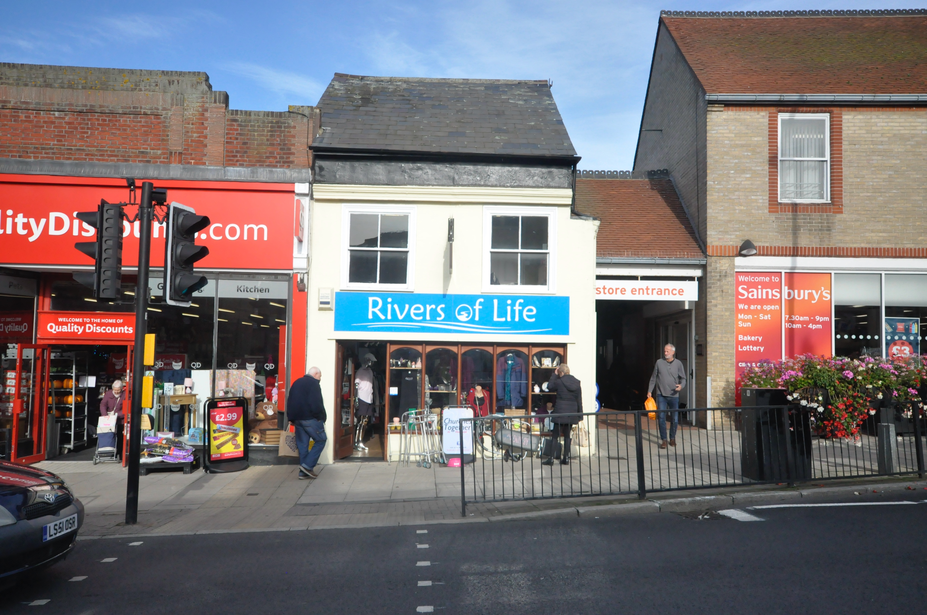
The church owns a shop on Halstead High Street, which is run as a charity shop. Despite the fellowship being small in number, they open three days per week. The shop provides good opportunities for outreach. Halstead Baptist Church is thankful for God’s provision that has enabled them to continue in spite of the prevailing difficult economic situation and high maintenance costs.
Please pray for
• New relationships that will produce fruit for the Kingdom
• New people to come alongside and support the fellowship
• Perseverance and wisdom for the days ahead and that God’s vision for the future of the Church will become clear.
Prayer Focus: Halstead Baptist Church

