Slide 1
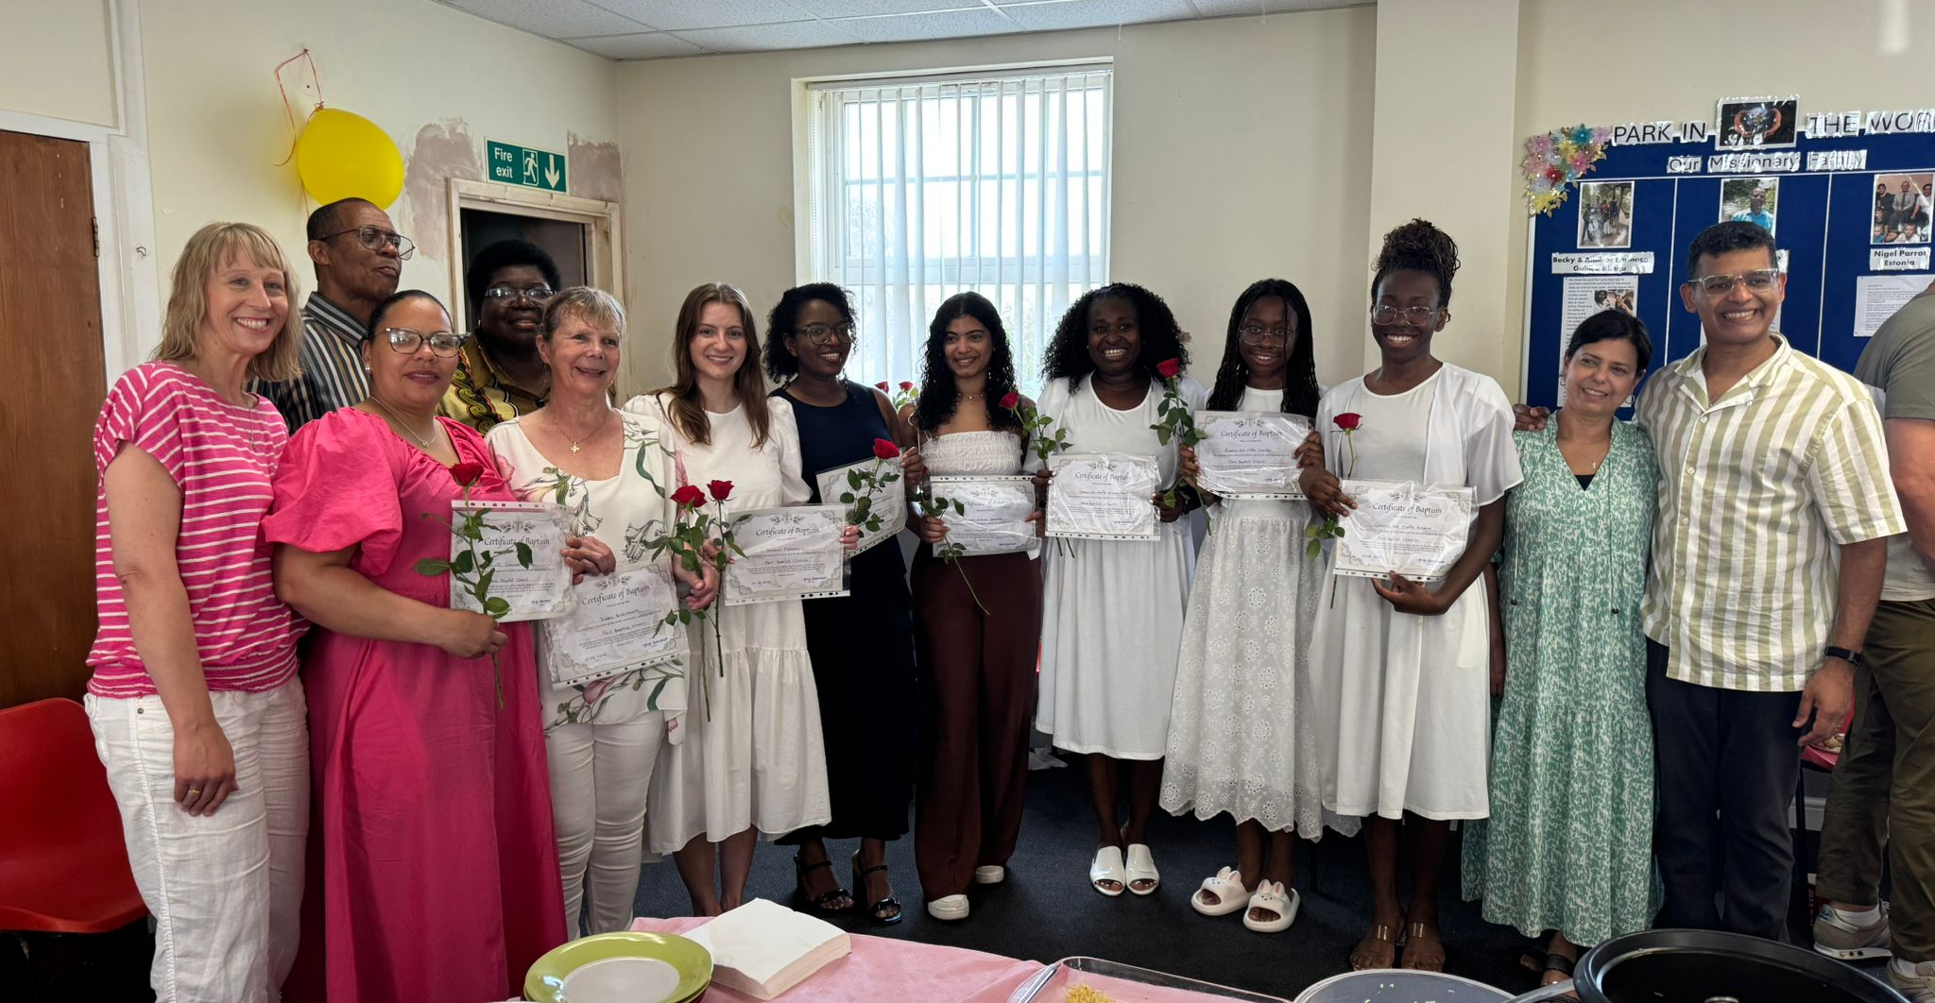
Park Baptist is a Bi-lingual, multi-cultural Church. Their vision is to be a praying community which wholeheartedly loves God, each other and welcomes people from all walks of life. They serve a diverse community in a deprived area.
They have services in English and Portuguese. Regular activities are a Friendship group, Game night, Art Group and Men’s and Women’s meetings. Hosting a “Warm hub” and weekly “YaYa” youth group for teenagers and young adults.
Their current Minister, Jorge Damasceno, helped to plant the Portuguese fellowship. They are seeking a new Minister for the English-speaking fellowship.
P
Prayer Focus: Park Baptist Church, Great Yarmouth

Slide 2
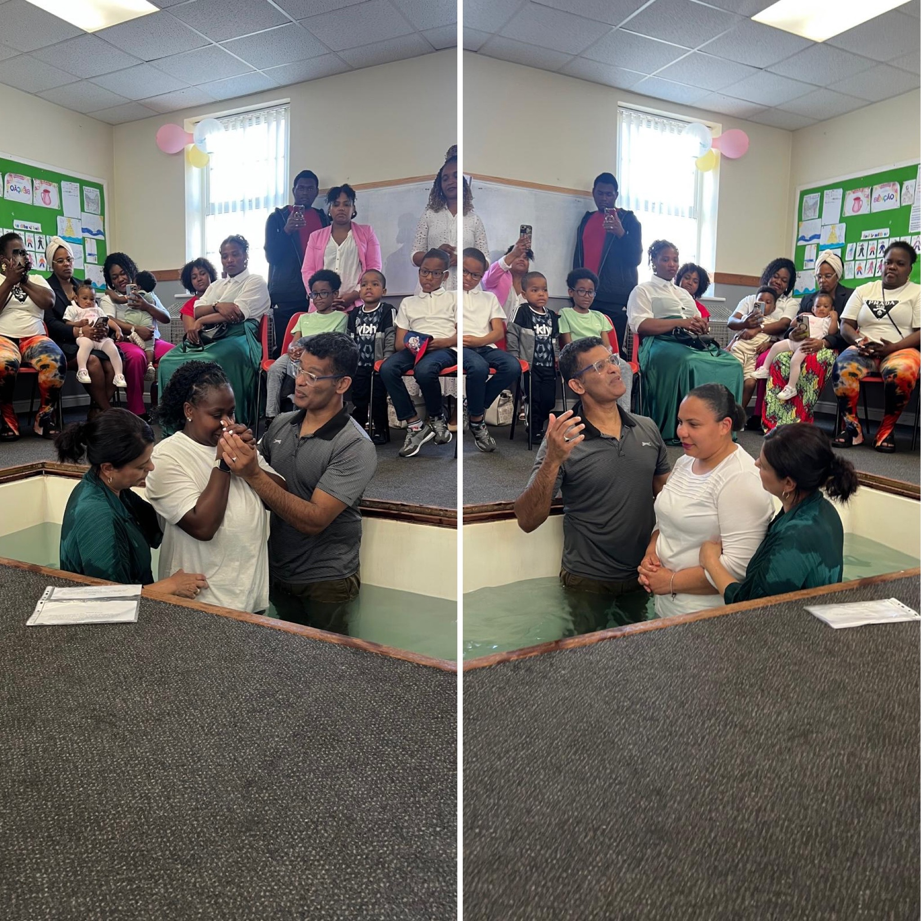
Both fellowships recently had a joint Baptismal service where 6 people from the Portuguese speakers and 2 from the English speakers were baptised. Please pray:
• For God’s provision as they seek another Minister
• That God will bless and protect the faith of those recently baptised
• For the Church to become more outward-looking. There are opportunities and challenges to serve vulnerable and struggling people.
• God will enable them to build relationships with young people who are 2nd-generation migrants who are vulnerable.
P
Prayer Focus: XXX Baptist Church

