Slide 1
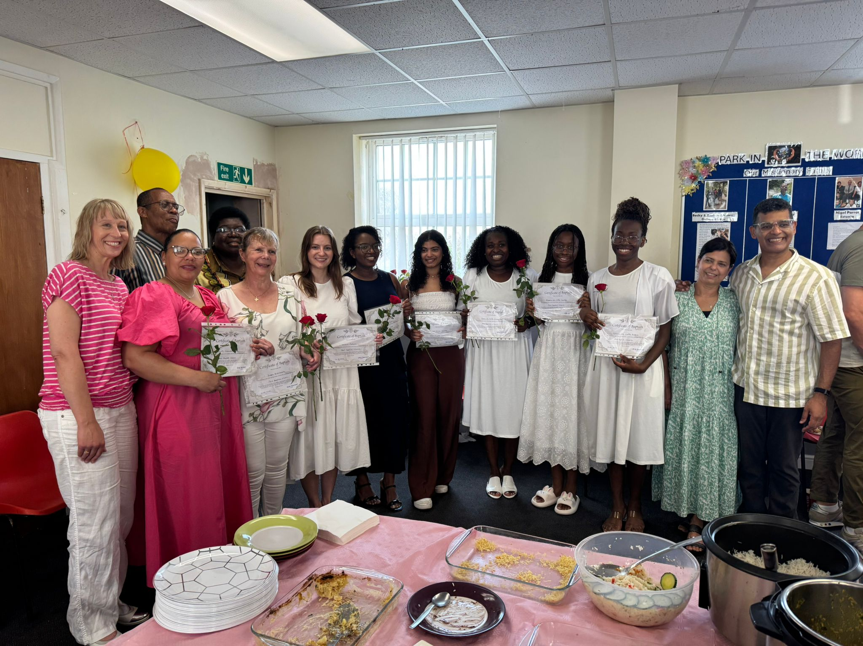
Park Baptist is a Bi-lingual, multi-cultural Church in Great Yarmouth. Their vision is to be a praying community which wholeheartedly loves God, each other and welcomes people from all walks of life. They serve a diverse community in a deprived area.
They have 2 weekly services: English-speaking Sunday morning (about 50 people), and Portuguese-speaking Saturday (50-60 people). Regular activities are a Friendship group, Game night, Art Group and Men’s and Women’s meetings. Hosting a “Warm hub” and weekly “YaYa” youth group for teenagers and young adults.
Their current Minister, Jorge Damasceno, helped to plant the Portuguese fellowship some years ago and returned to Park Baptist to lead the work of the Church. They are seeking a new Minister for the English-speaking fellowship.
Prayer Focus: Park Baptist Church

Slide 2
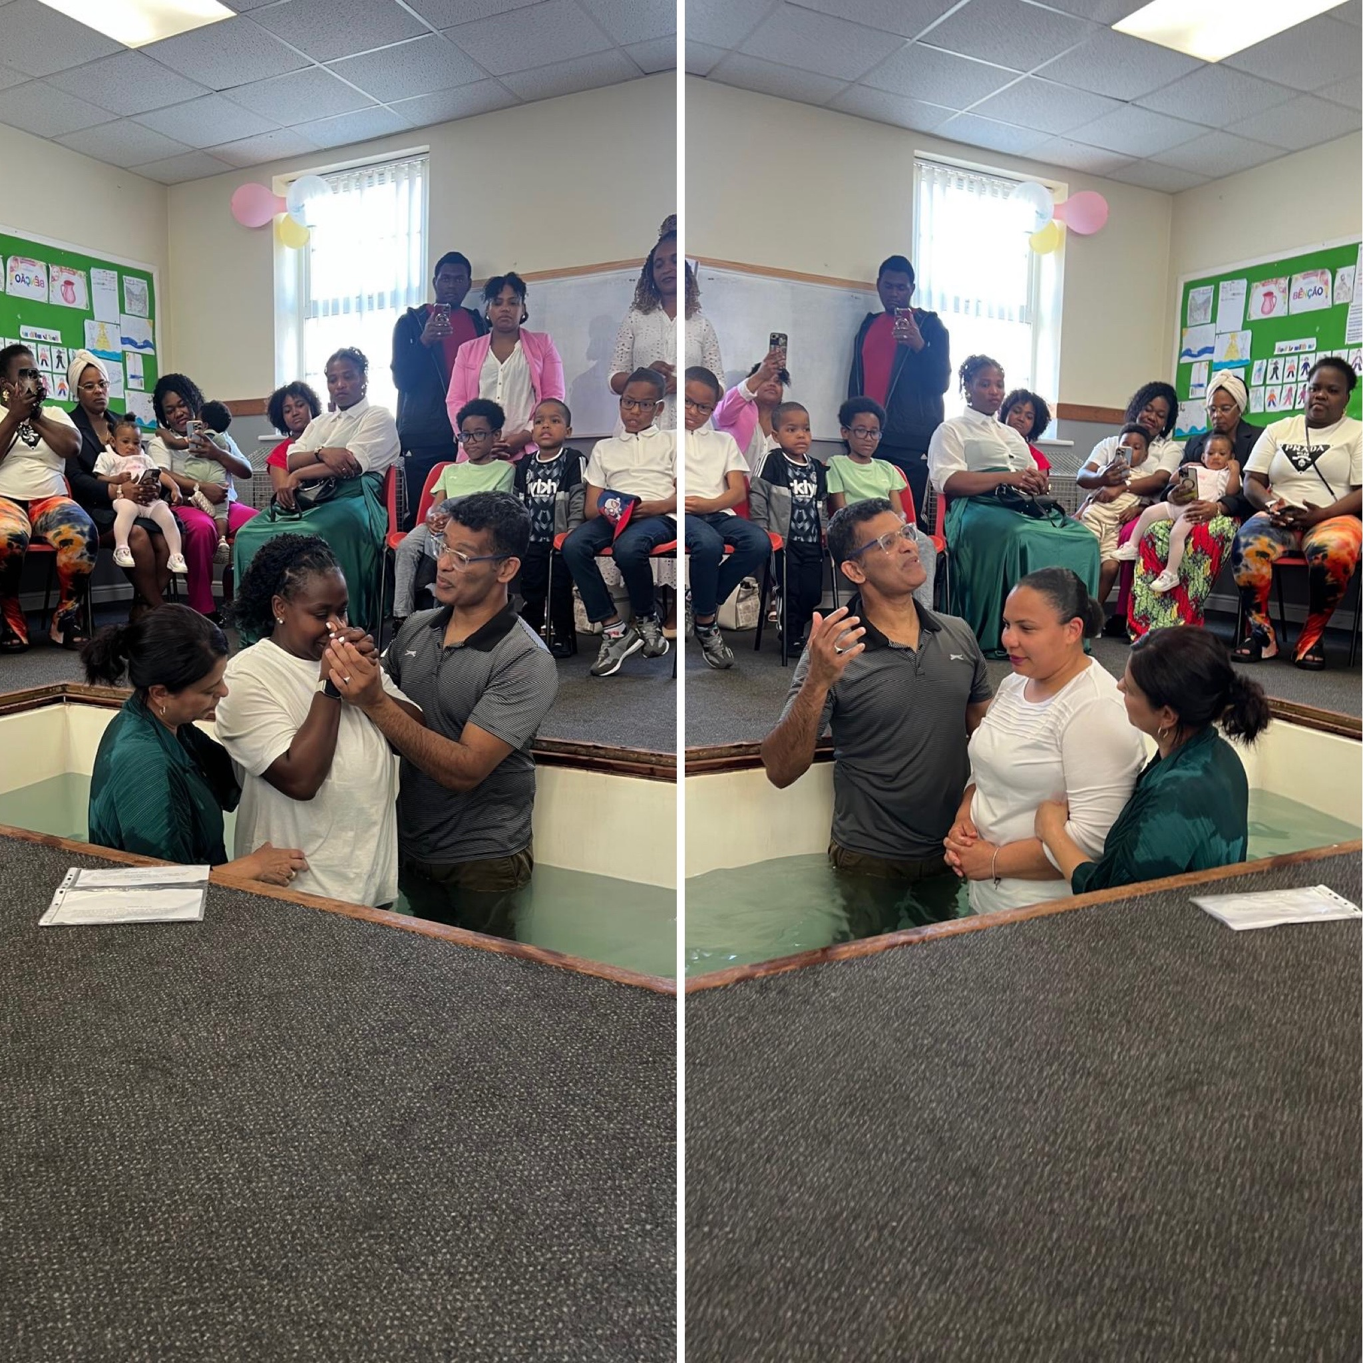
Both fellowships join together, occasionally, and recently had a joint Baptismal service where 6 people from the Portuguese speakers and 2 from the English speakers were baptised. Please pray:
• for God’s provision as they seek another Minister
• that God will bless and protect the faith of those recently baptised
• For the Church to become more outward-looking. There are opportunities and challenges to serve vulnerable and struggling people. May God’s wisdom, discernment, and resources enable us to reach out with practical and spiritual help.
• God will enable them to build relationships with young people who are 2nd generation migrants who sometimes struggle to know “where they belong” and are vulnerable.
Prayer Focus: Park Baptist Church

