Slide 1
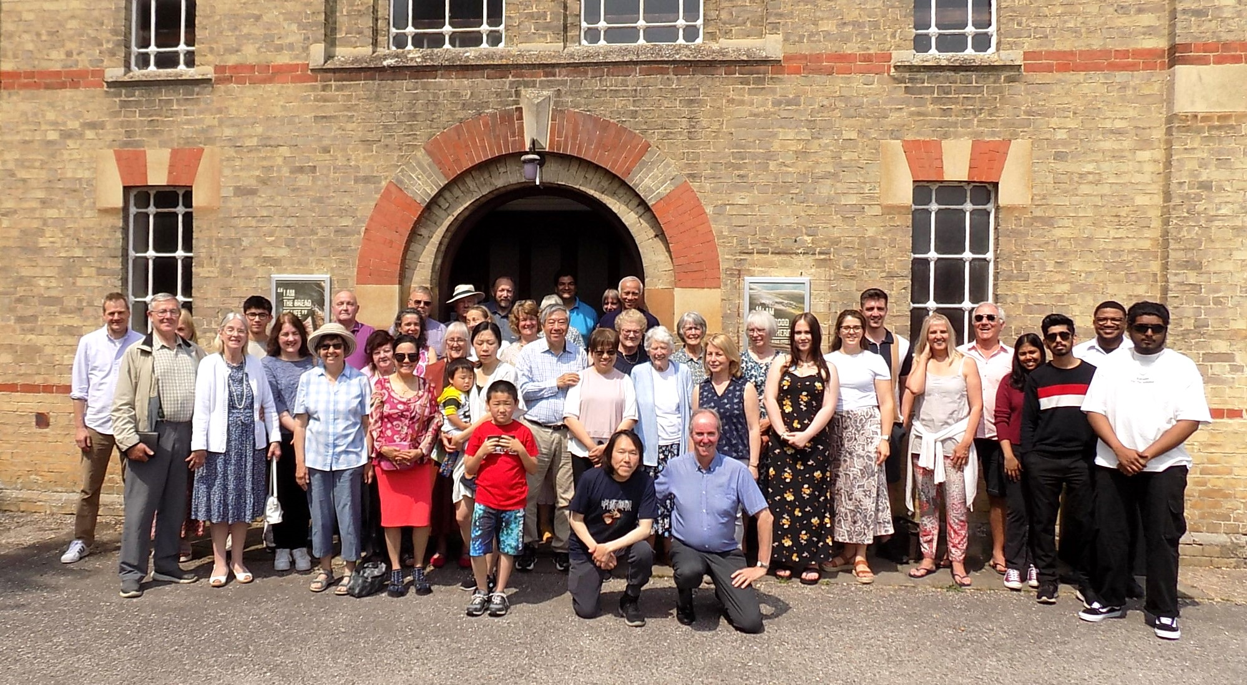
Harston Baptist Church lies in a village five miles south of Cambridge ideally situated for commuting to Cambridge and London. The population of around 1800 is largely affluent, although there is some social housing.
The story of the church began in 1759 when a vicar John Berridge from Bedfordshire preached in the main street. Originally meeting in barns a church was established in 1786 and our present building was built in 1870. We have approximately 40 gathering for worship on a Sunday morning.
Scott Paton has been their minister since October 2011 and hails originally from Peterhead in Scotland. The church’s vision is to maintain an upward, inward and outward focus. They meet on Sundays and through the week for worship, teaching, prayer, communion and fellowship.
Prayer Focus: Harston Baptist Church

Slide 2
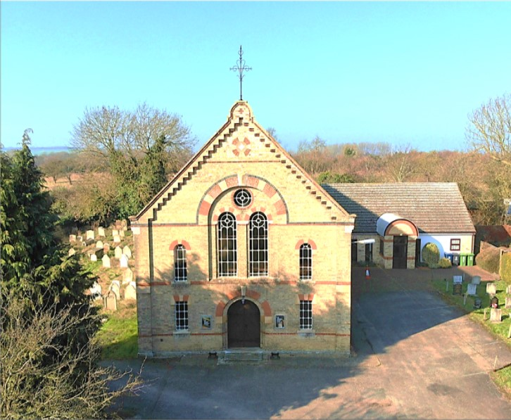
The church has been blessed through opening its doors to the community. From a homeschooling community to a Community Food Hub. The Food Hub has given the church far greater opportunities to connect with the local community and by God’s grace a number have become part of the church family.
Please pray;
• That we would continue to have the upward, inward and outward vision God desires
• For more children and families to start attending the church.
• That God would continue to bless our community connections and result in people coming to Christ and being part of his family.
• That God would provide more deacons.
Prayer Focus: Harston Baptist Church

