Slide 1
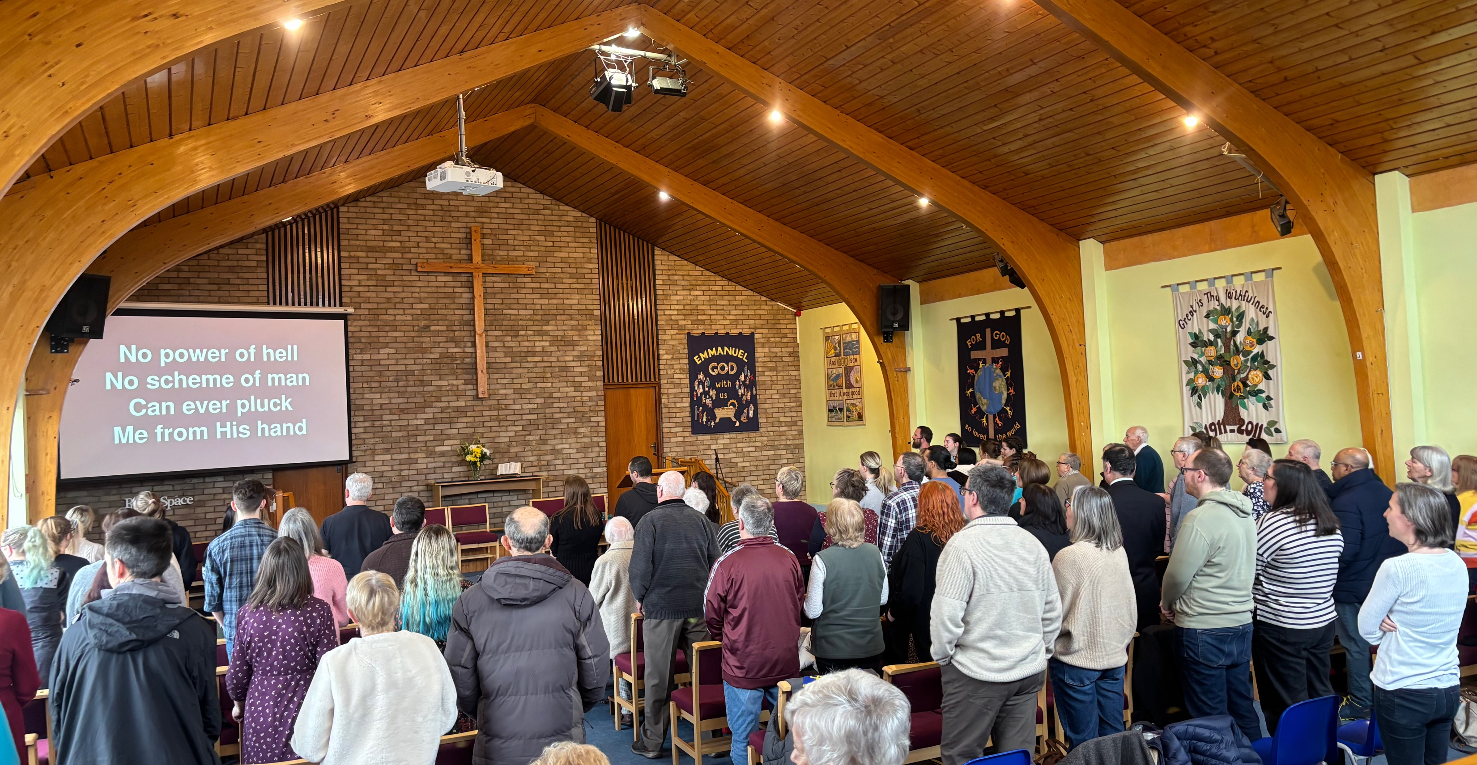
EBC is a lovely community in a small village. This year, they have the theme of wonder: the wonder of God, of the church, of prayer and of us.
They are excited about the 5 baptisms that they have had this year, the new worship band after years of recorded music, and the young people who are stepping up in their gifts. They have a great community focus with toddler groups, foodbank, dementia friendly café, children and youth groups, and schools for assemblies and lessons. However, they are also focused on their own spiritual growth, being more confident in God and one another, with House group attendance growing.
P
Prayer Focus: Eastwood Baptist Church, Southend-on-Sea

Slide 2
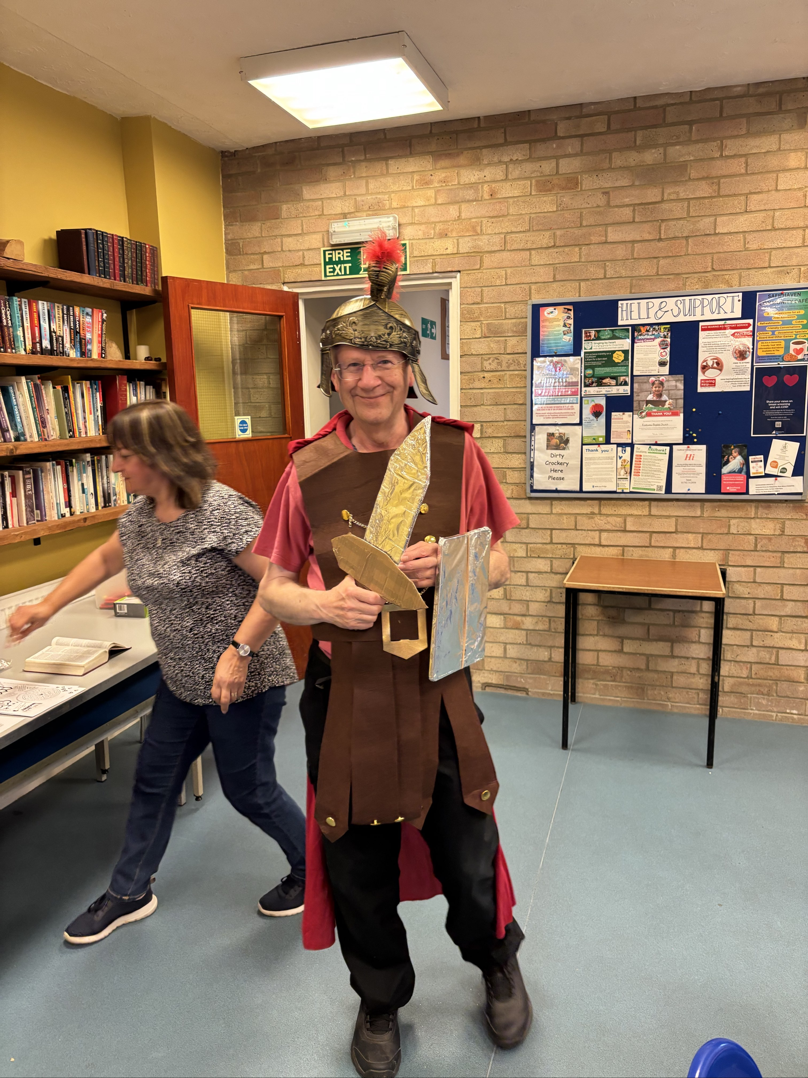
Their Minister, Martin, is looking forward to encouraging people in God’s calling and discipling those who have been baptised. He is passionate about Youth Camp and peer-to-peer discipleship. Please pray with them:
• For those who have been baptised, that they may grow deeper in spiritual knowledge and experience fellowship within the church.
• For all generations to feel at home and serve one another
• For God to be audible about what the next adventure is.
P
Prayer Focus: XXX Baptist Church

