Slide 1
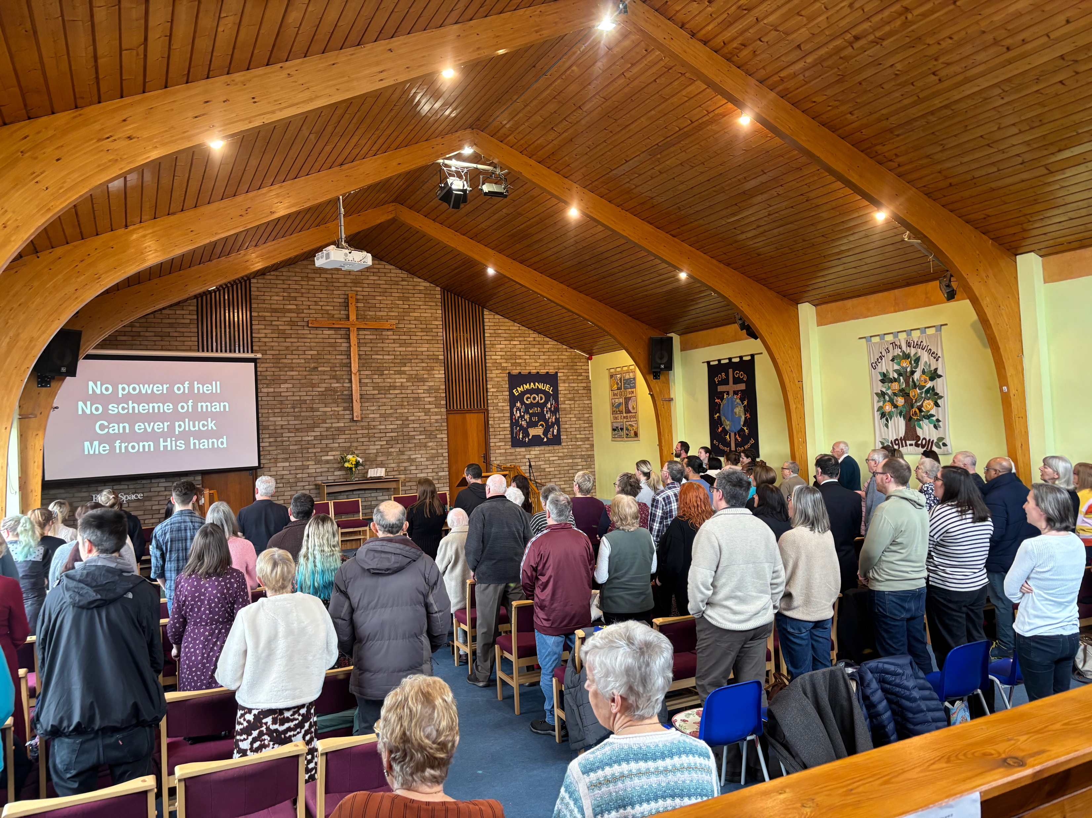
Eastwood Baptist Church is a lovely community in a small village on the edge of Southend-on-Sea. This year, they have the theme of wonder; this is looking at the wonder of God, the wonder of the church, the wonder of prayer and the wonder of us. They are excited about the 5 baptisms that they have had this year, the new worship band after years of recorded music, and the young people who are stepping up in their gifts. They have a great community focus with 2 toddler groups, a foodbank, a council-recognised dementia friendly café, children and youth groups for primary and older children, and they work in 3 primary schools for assemblies and lessons. However, they are also focused on their own spiritual growth, being more confident in God and one another, with House group attendance growing.
Prayer Focus: Eastwood Baptist Church

Slide 2
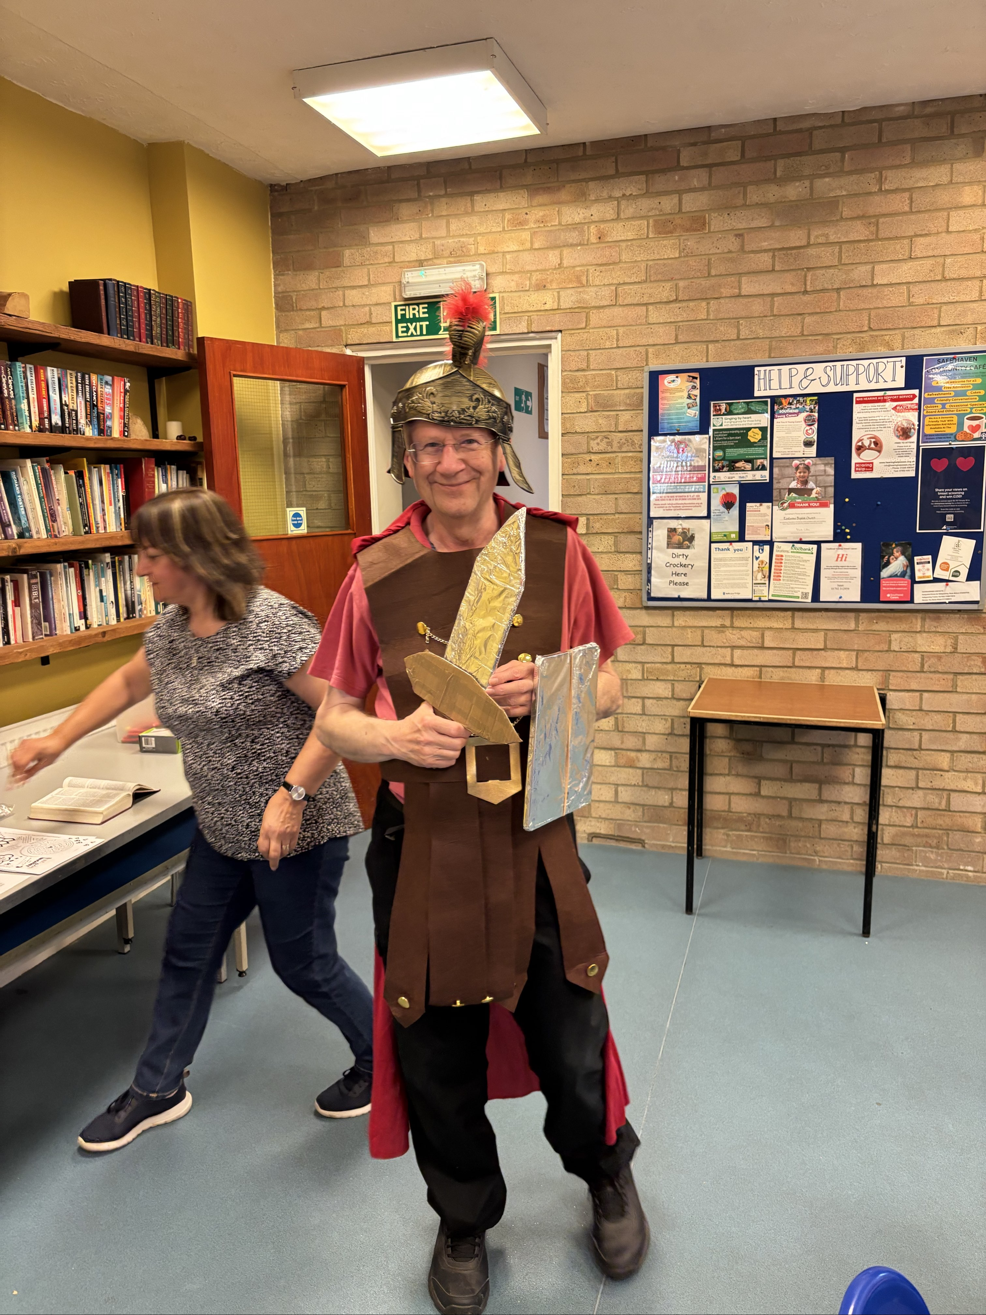
Their Minister is Martin, who is just finishing his NAMS (Newly Accredited Minister). He is looking forward to encouraging people in what God calls them to and discipling those who have been baptised. He is passionate about the Satellite Youth Camp and the peer-to-peer discipleship that they see. Together with the church, he is discerning what God is calling them to next. Please pray with them: • For those who have been baptised, that they may grow deeper in spiritual knowledge and experience fellowship within the church. • For all generations to feel at home and serve one another • For God to be audible about what the next adventure is.
Prayer Focus: Eastwood Baptist Church

