Slide 1
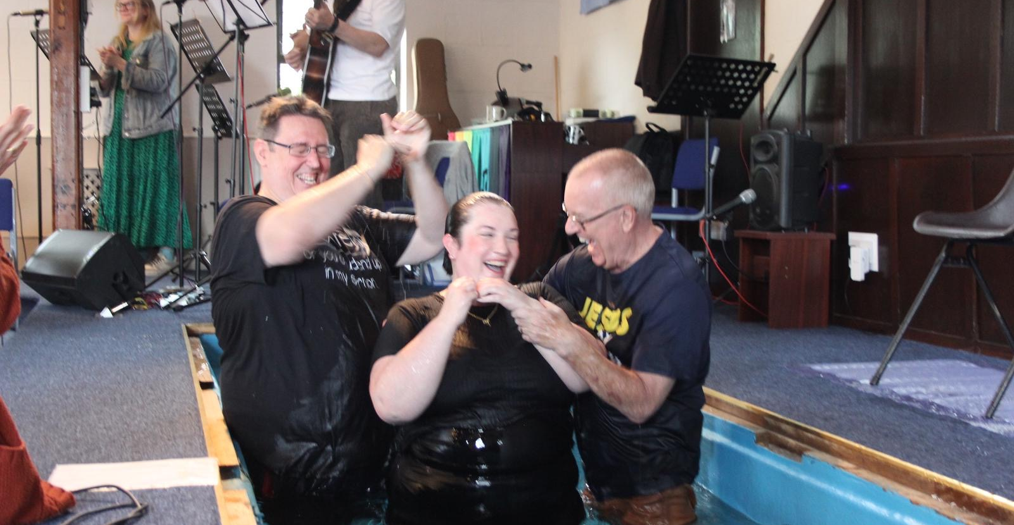
HBC has been present in the town for almost 99 years and is led by an elder, deacons and Tom Pender is their student minister.
The church has regular activities, including a ladies group, a regular prayer and bible study group, an indoor bowls group and Tots and craft groups. They are involved at the local primary school with assemblies and children also visit the church at times.
2026 will be their centenary year with celebrations already being planned. The church is creating a community garden, which will be a reflective and diverse place for the community, also including a hands-on area for children.
P
Prayer Focus: Hadleigh Baptist Church, Essex

Slide 2
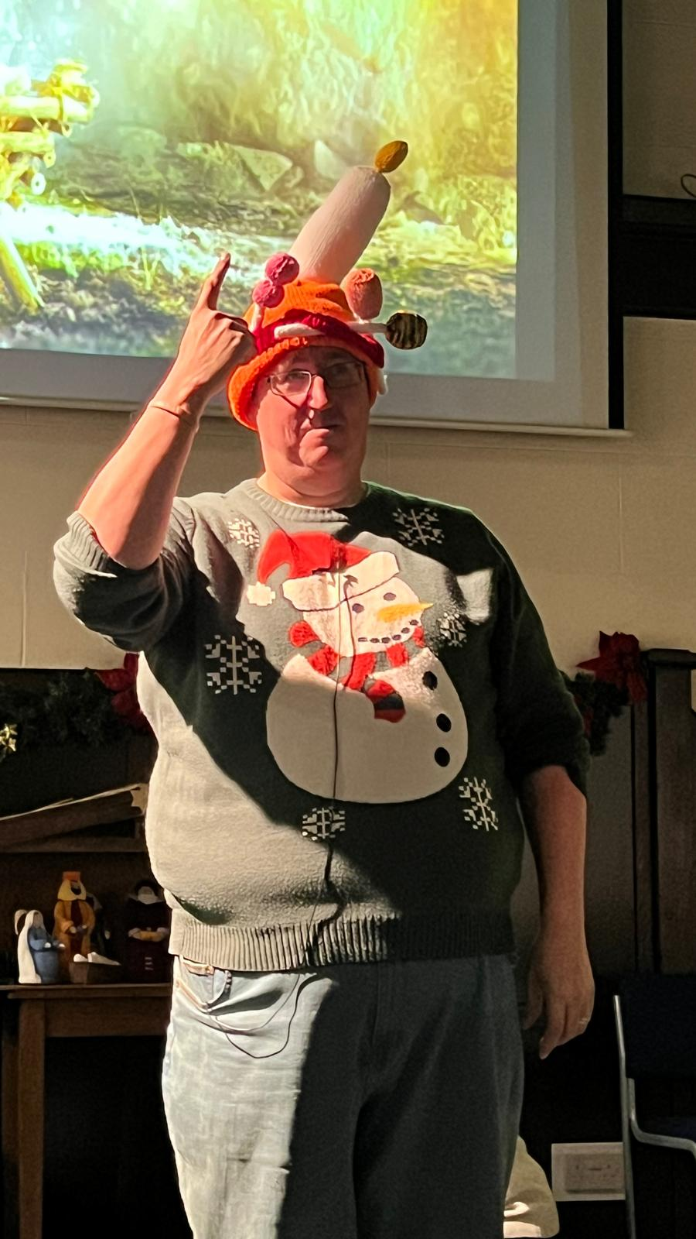
HBC aims to build on community and school involvement to demonstrate that the church is not a strange place but welcomes everyone. They seek to attend the town’s Christmas and Summer fairs, giving things away and blessing people.
The church has been encouraged by increasing church attendance and would pray for:
- All its preparations for their centenary celebrations in June 2026.
-For its work within the community, ‘If church disappeared would people notice?’
-And for discernment to see how and where God is directing the church’s direction.
P
Prayer Focus: Hadleigh Baptist Church

