Slide 1
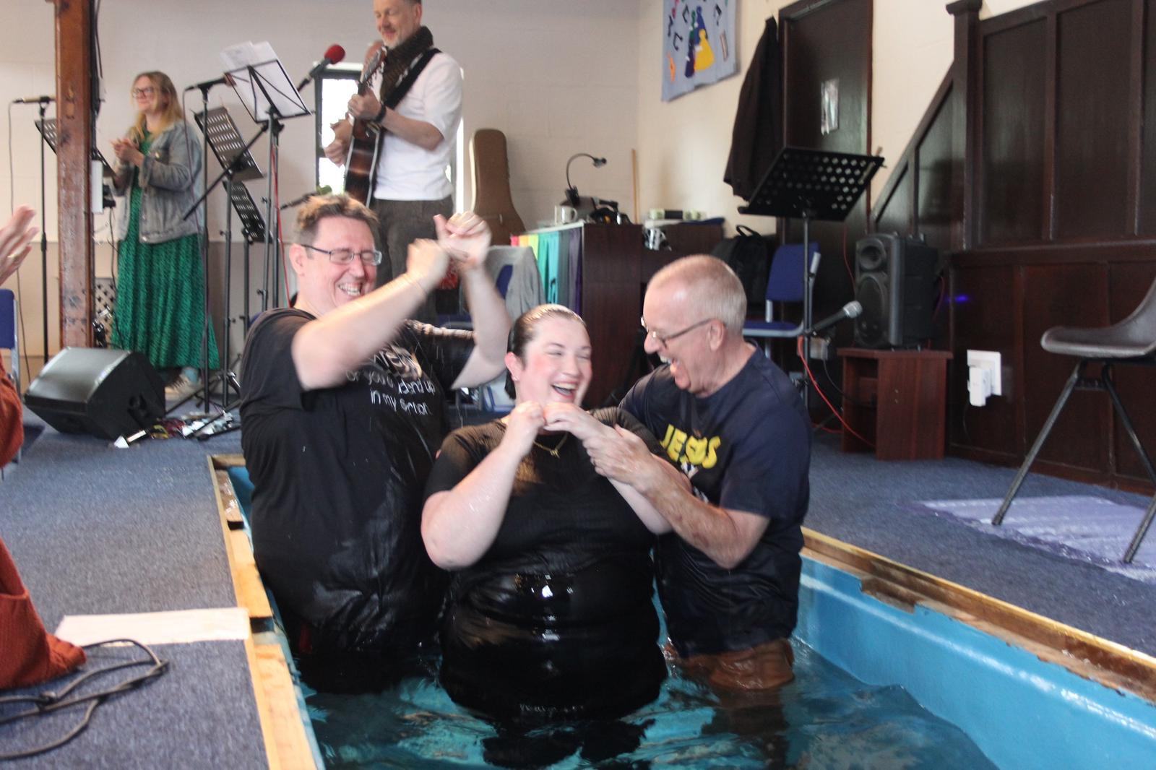
HBC, Essex has been present in the town for almost 99 years and has a leadership comprising an elder, deacons and Tom Pender is their student minister. Tom will shortly complete his 2nd year of ministerial training at Spurgeon’s College.
The church has a number of regular activities, including a ladies group, a regular prayer and bible study group, an indoor bowls group and Tots and craft groups, aiming to reach out to the community. There is also involvement at the local primary school with assemblies and children also visit the church at times.
2026 will be their centenary year with celebrations already being planned. The church is creating a community garden, which will be a reflective and diverse place for the community, also including a hands-on area for children.
Prayer Focus: Hadleigh Baptist Church

Slide 2
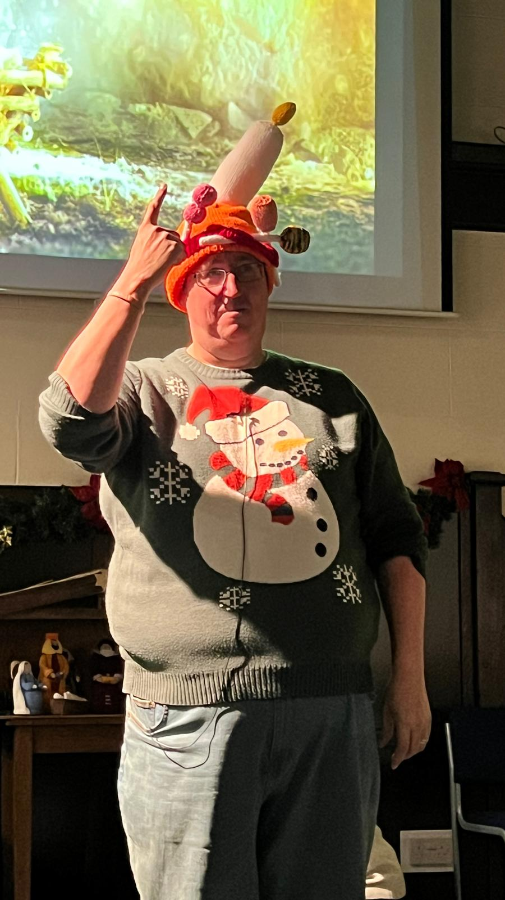
Future aims are for the church to build on community and school involvement with the aim of demonstrating that church is not a strange place but welcomes everyone. In the interim they seek to attend the town’s Christmas and Summer fairs, giving things away and blessing people, something which surprises people, to receive something free.
The church has been encouraged by seeing an increase in church attendance over the last year and would value prayer for:
- All its preparations for their centenary celebrations in June 2026.
-For its work within the community, ‘If church disappeared would people notice?’
-And for discernment to see how and where God is directing the church’s direction.
Prayer Focus: Hadleigh Baptist Church

