Slide 1
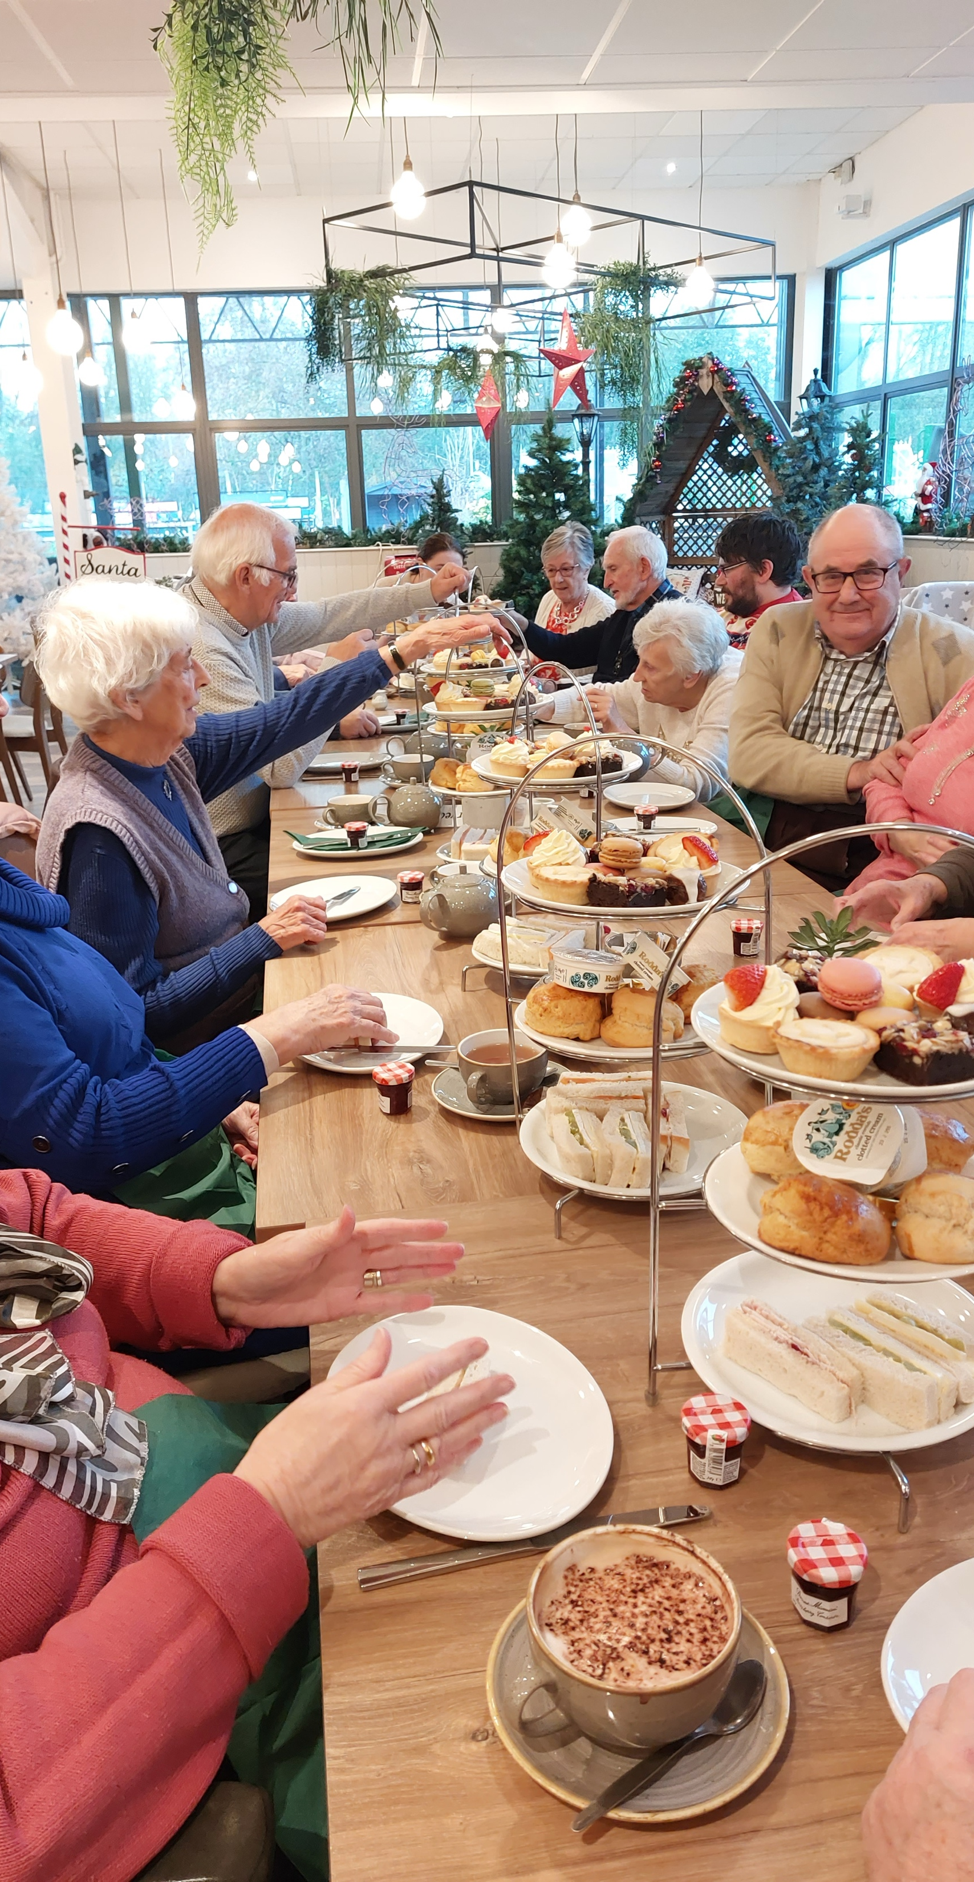
Perry is a village of around three hundred homes, and Perry Baptist Church is the only church in the village. Undern the leadership of their Minister, Jon Magee, this small, but growing fellowship seeks to serve and build relationships with the local community, organising events and services around national and local events; the anniversary of V.E. Day being a recent example. Jon has seen the fellowship grow to a close community of believers with a heart to serve the village in which they live.
The church also invites local celebrities who have become Christians to share their testimonies and views this as a great evangelistic tool.
P
Prayer Focus: Perry Baptist Church, Nr Huntingdon

Slide 2
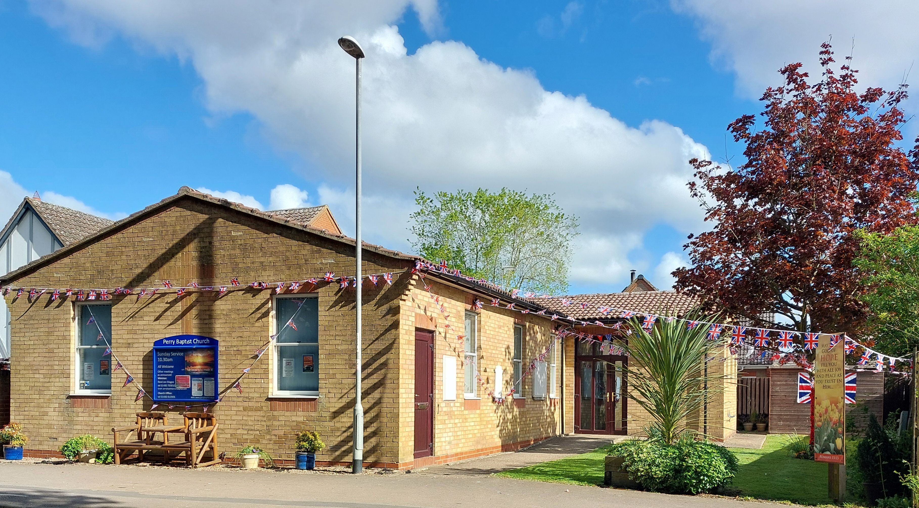
Please Pray:
* The fellowship ask you to join them in thanking God for the opportunities they have to share His love, and their faith with their fellow villagers.
* In a village with a large, retired population, they also ask for prayer for the health issues affecting their membership.
* Please also pray for ongoing links with their local community, seeing more Perry residents coming to faith.
P
Prayer Focus: Perry Baptist Church

