Slide 1
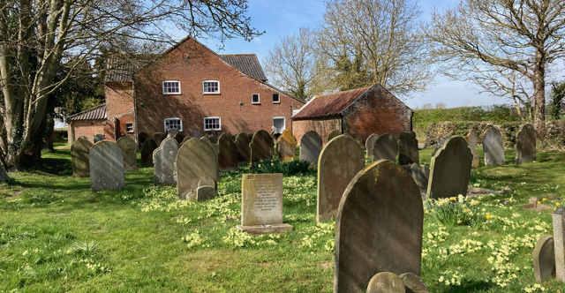
Neatishead Baptist Church stands outside the village, surrounded by fields. A small, faithful, generous, welcoming elderly congregation, strong in faith, is made up of villagers and a gathered congregation from around. Some have worshipped at NBC all their lives, some have longstanding family links, while others have retired into the area. After their last part-time pastor, an internal ministry team was formed, and this, together with visiting worship leaders, has given them a variety of services which challenge, encourage and demand a response from the fellowship.
They meet every Sunday and have coffee and a ‘mardle’ afterwards.
P
Prayer Focus: Neatishead Baptist Church, Norfolk Broads

Slide 2
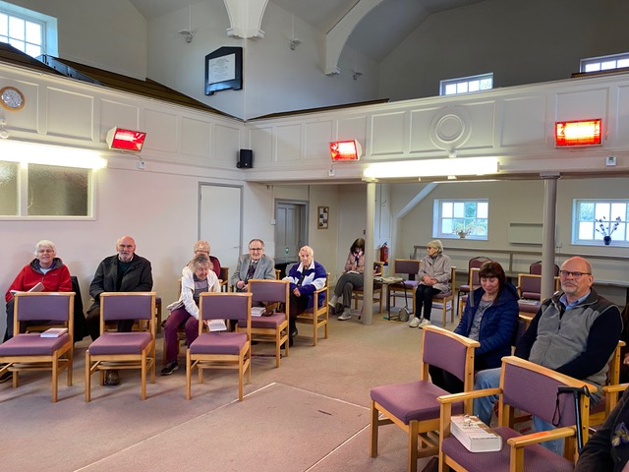
Neatishead Baptist Church also have a monthly Hope Café that natters, does puzzles and games, a monthly prayer meeting, and fortnightly bible study/fellowship meetings alongside a Monthly Classic film club that reaches into the community.
Please pray:
• That they continue to support one another and extend that ministry to others
• That they continue to spiritually thrive, and that is rewarded by thriving numbers
• Please bless all those whom they donate to.
P
Prayer Focus: Neatishead Baptist Church

