Slide 1
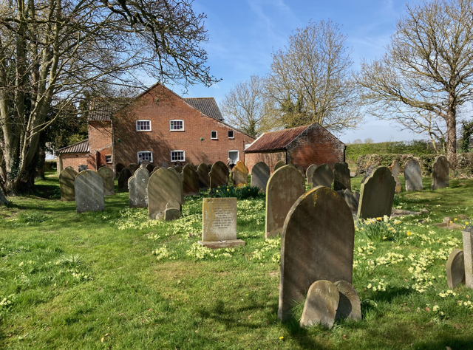
Neatishead Baptist Church stands outside the village, in the Norfolk Broads, surrounded by fields. A small, faithful, generous, welcoming elderly congregation, strong in faith, is made up of villagers and a gathered congregation from around. Some have worshipped at NBC all their lives, some have longstanding family links, while others have retired into the area. After their last part-time pastor left three years ago, an internal ministry team was formed, which has links with the Iona Community, and this, together with visiting worship leaders, has given them a variety of services which challenge, encourage and demand a response from the fellowship. They meet every Sunday and have coffee and a ‘mardle’ afterwards.
Prayer Focus: Neatishead Baptist Church

Slide 2
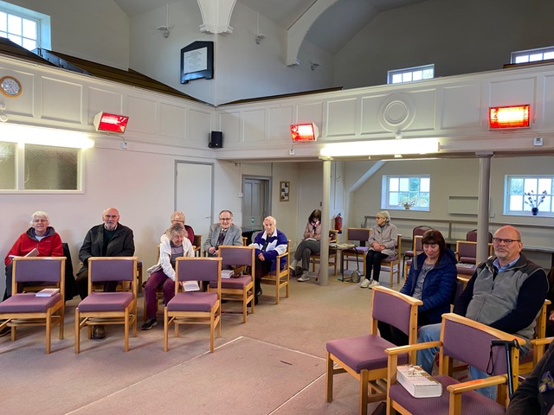
Neatishead Baptist Church also have a monthly Hope Café that natters, does puzzles and games, a monthly prayer meeting, and fortnightly bible study/fellowship meetings alongside a Monthly Classic film club that reaches into the community. They continue to seek how to minister to their village and support the central community hall in its many activities. Please pray: • That they continue to support one another and extend that ministry to others • That they continue to spiritually thrive, and that is rewarded by thriving numbers • Please bless all those whom they donate to.
Prayer Focus: Neatishead Baptist Church

