Slide 1
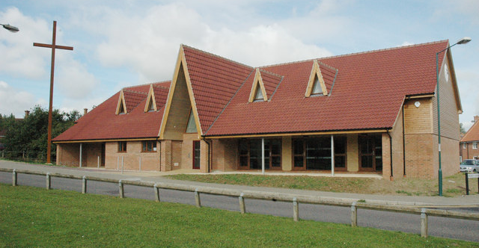
The Church in Great Notley is a Local Ecumenical Partnership (LEP) formed between Anglican, Baptist, Methodist and URC. The current Minister is Rev Rachel Prior, who is the Anglican Incumbent, supported by Rev David Sebley a URC Minister.
The vision for an ecumenical church emerged from a woman’s prayer group in 1994. In 1998, they met in a leaky portacabin but by 2010 the fellowship had their own building.
Although it is a partnership of four denominations, it is one congregation which meets on a Sunday morning, sharing in worship that follows their varying traditions.
P
Prayer Focus: Great Notley Church

Slide 2
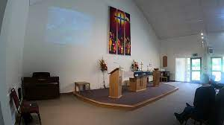
The Church in Great Notley is a vibrant and active community. Activities include Foodbank, Coffee Mornings, a baby and toddler group, Snackanory and Wiggle Church. The local school is visited by Rev Rachel and volunteers as they deliver cake to the staff!
Please Pray for:-
• A greater involvement of the EBA in the life of the Church in Great Notley
• A faithfulness to their vision to be The Church in Great Notley for Great Notley
• For more opportunities to bless their community.
P
Prayer Focus: Great Notley Church

