Slide 1
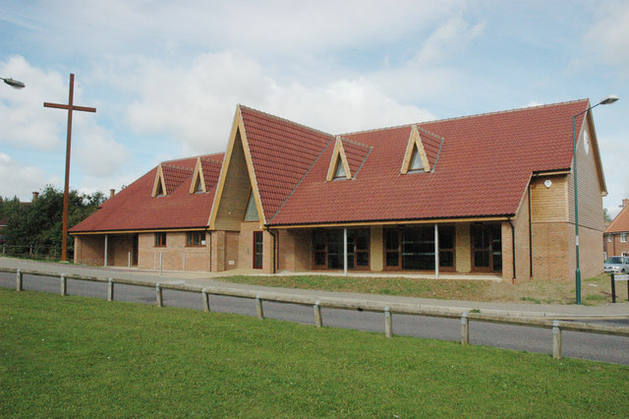
The Church in Great Notley is a Local Ecumenical Partnership (LEP) formed between Anglican, Baptist, Methodist and URC. The current Minister is Rev Rachel Prior, who is the Anglican Incumbent, supported by Rev David Sebley a URC Minister. The vision for an ecumenical church in Great Notley, emerged from a woman’s prayer group in 1994. The first service was on 13th Jan 1998, meeting in a leaking portable cabin in the centre of the village. In September 2002 they held their 1st Service in the Community Centre and by August 2010 the fellowship were able to meet in their own building. The Church in Great Notley is distinctive in that, although it is a partnership of four denominations, it is one congregation which meets on a Sunday morning, sharing in worship that follows the traditions of the denominational partners.
Prayer Focus: Great Notley Church

Slide 2
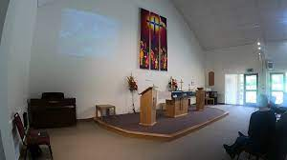
As a fellowship, the Church in Great Notley is a vibrant and active community. Foodbank, Coffee Mornings, Children and Family work, including a baby and toddler group, Snackanory and Wiggle Church for primary school age children. The local school is visited by Rev Rachel and volunteers as they deliver cake to the staff! Please Pray for:- • A greater involvement of the EBA in the life of the Church in Great Notley • A faithfulness to their vision to be The Church in Great Notley for Great Notley • For more opportunities to bless their community.
Prayer Focus: Great Notley Church

