Slide 1
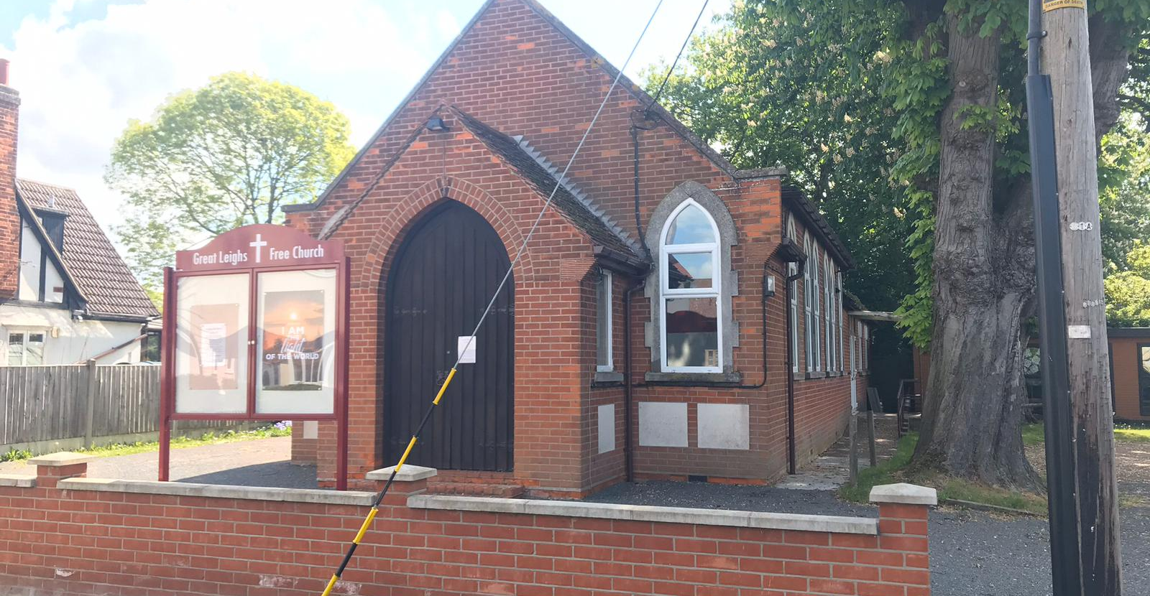
Great Leighs Free Church is situated between Braintree and Chelmsford is the relatively small village of Great Leighs and is led by a Ministry Team. They are an active fellowship of 30 members and a regular Sunday congregation of around 40. Activities, other than the usual Sunday morning service and a monthly Sunday afternoon ‘get together’, are Boys and Girls Brigade companies, a Toddler group, ‘Spring’ coffee morning, Bible studies, prayer meetings (on Zoom) and monthly Prayer Breakfasts and Lunch Club.
P
Prayer Focus: Great Leighs Free Church

Slide 2
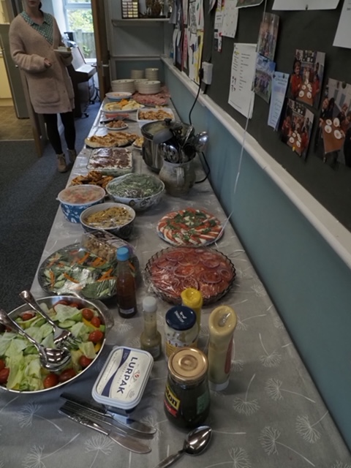
2025 offers opportunities through family services and their prayer is that activity can be translated into people coming to know Jesus as their Saviour. Please Pray:- • For visitors to the Church to meet Jesus • For encouragement for the fellowship • For the leadership team as they seek to be faithful to God’s calling
P
Prayer Focus: Great Leighs Free Church

