Slide 1
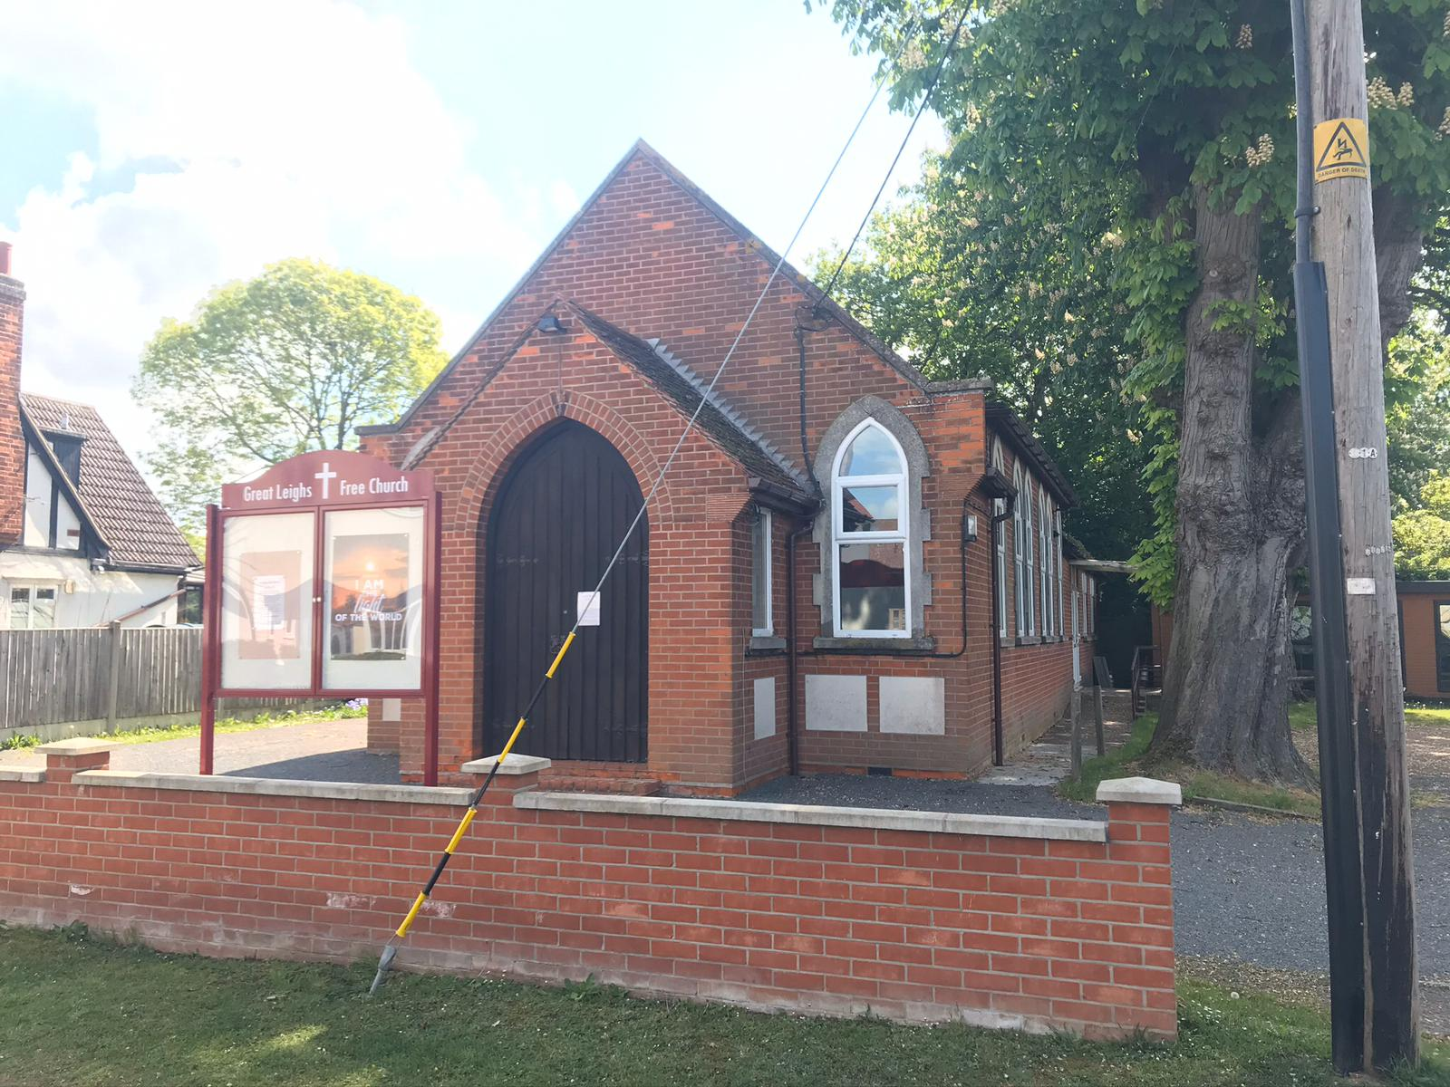
Situated in the relatively small village of Great Leighs, between Braintree and Chelmsford, is the Fellowship of Great Leighs Free Church. The church has not had a minister since 2005/6 and is now led by a Ministry Team. Great Leighs Free Church is an active fellowship of 30 members and a regular Sunday congregation of around 40. Activities, other than the usual Sunday morning service (with activities for children) and a monthly Sunday afternoon ‘get together’ with tea following, are Boys and Girls Brigade companies, a Toddler group, ‘Spring’ coffee morning, Bible studies, prayer meetings (on Zoom) and monthly Prayer Breakfasts and Lunch Club. During the winter months they also ran a Warm Space.
Prayer Focus: Great Leighs Free Church

Slide 2
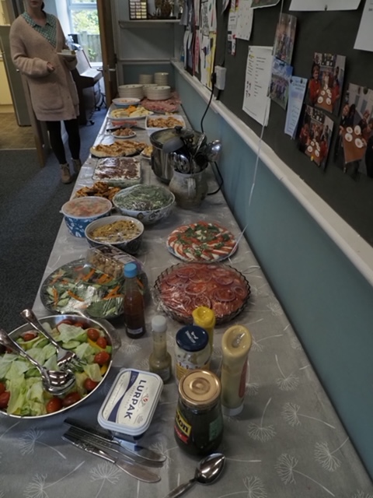
The fellowship deliver the Good News newspaper around the village so that every house receives a copy every 4 months. 2025 offers opportunities through family services and their prayer is that activity can be translated into people coming to know Jesus as their Saviour. Please Pray:- • For visitors to the Church to meet Jesus • For encouragement for the fellowship • For the leadership team as they seek to be faithful to God’s calling
Prayer Focus: Great Leighs Free Church

