Slide 1
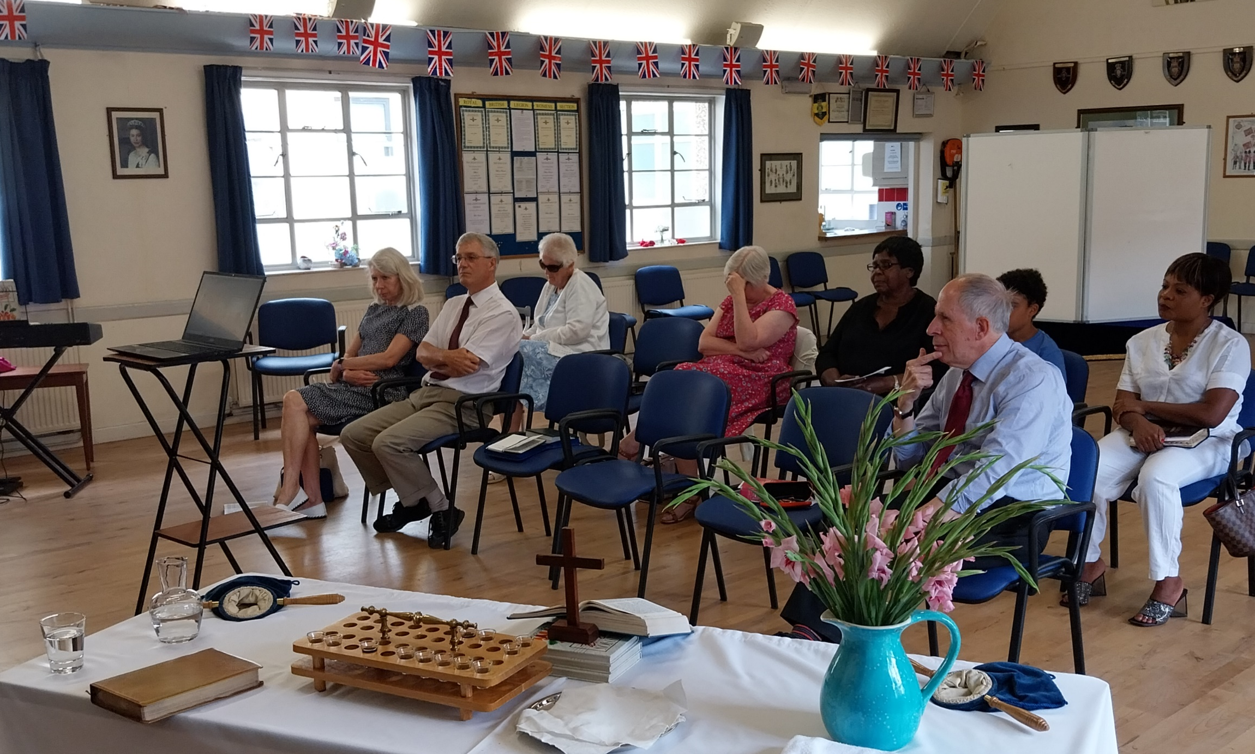
Witham Baptist Church, led by Rev Michael Child who has been the Minister since the foundation of the church, meets every Sunday morning at the Royal British Legion Hall, Newland Street in Witham, Essex. Although not owning their own premises can be a challenge, and numbers have decreased after the pandemic, this small congregation is not at all disheartened, but they live out the church’s vision to ‘seek God in whatever they do’ and serve in the community. During the week, they have in-person prayer meetings as well as online meetings via Zoom. The latter one has seen an increase in attendance by doubling its numbers and this is particularly encouraging as people join to pray over Zoom, not only from Witham but also from Ipswich and Southend.
Prayer Focus: Witham Baptist Church

Slide 2
Please pray for: * A few more workers to join God’s ministry at Witham Baptist Church. * The health of the current acting church secretary. * The church secretary position to be filled up. * Necessary equipment and volunteers to be able to livestream Sunday services and reach more people. * For the people who left the congregation, that they may return. * For the church to remain strong as they continue to grow.
Prayer Focus: Witham Baptist Church

