Slide 1
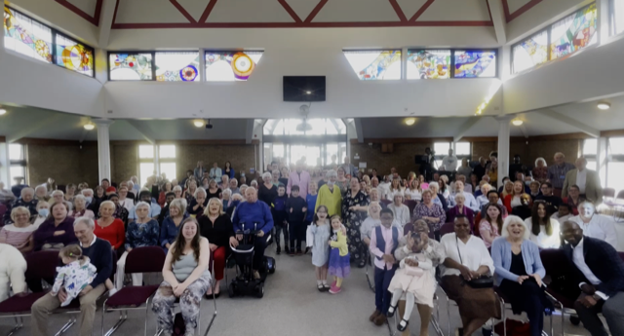
Shoeburyness and Thorpe Bay are the two communities that form the eastern edge of the City of Southend-on-Sea. At the start of November STBBC launched their vision/framework for the next season of church life – Hope & Hospitality. God is definitely stirring the waters and there is anticipation and excitement about how things are developing. The church is active in their community, especially through work with children, young people and their Parish Nursing Team.
P
Prayer Focus: Shoeburyness and Thorpe Bay Baptist Church

Slide 2
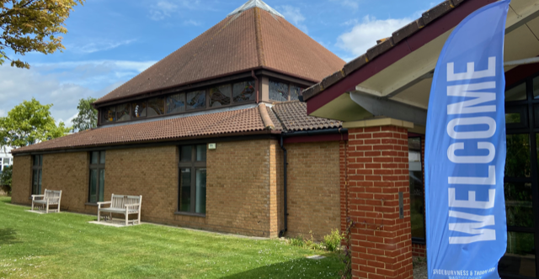
* Pray for the Elders and Trustees as they work through the various challenges and strategic decisions facing the church.
* For the appointment of a new Youth Worker in January 2023.
* For the good welcome and integration of new people attending each week.
P
Prayer Focus: Shoeburyness and Thorpe Bay Baptist Church

