Slide 1
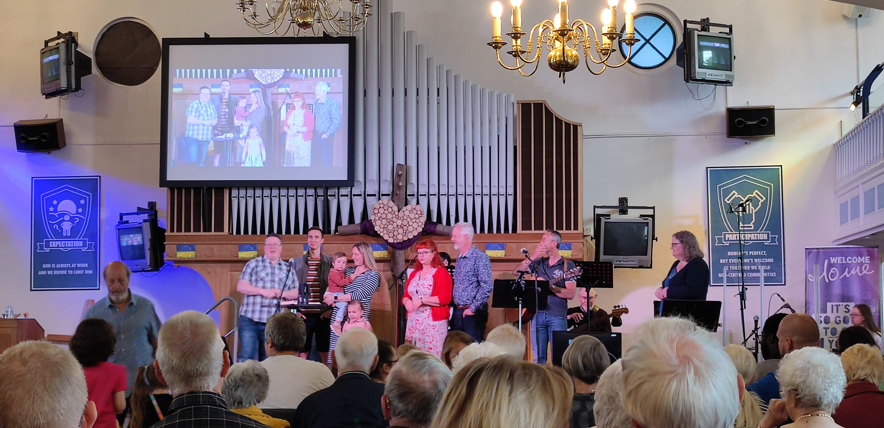
P
Rayleigh is located between Chelmsford and Southend-on-Sea and has been home to Rayleigh Baptist Church since 1799. Today Rayleigh is a large church which has seen a lot of change over the past few years. Rev Ricky Rew has been there for five years and currently leads the church’s ministry team. As part of looking forward the church has taken a step of faith with a major building project called the Base and the builders are well advanced with it.
Prayer Focus: Rayleigh Baptist Church

Slide 2
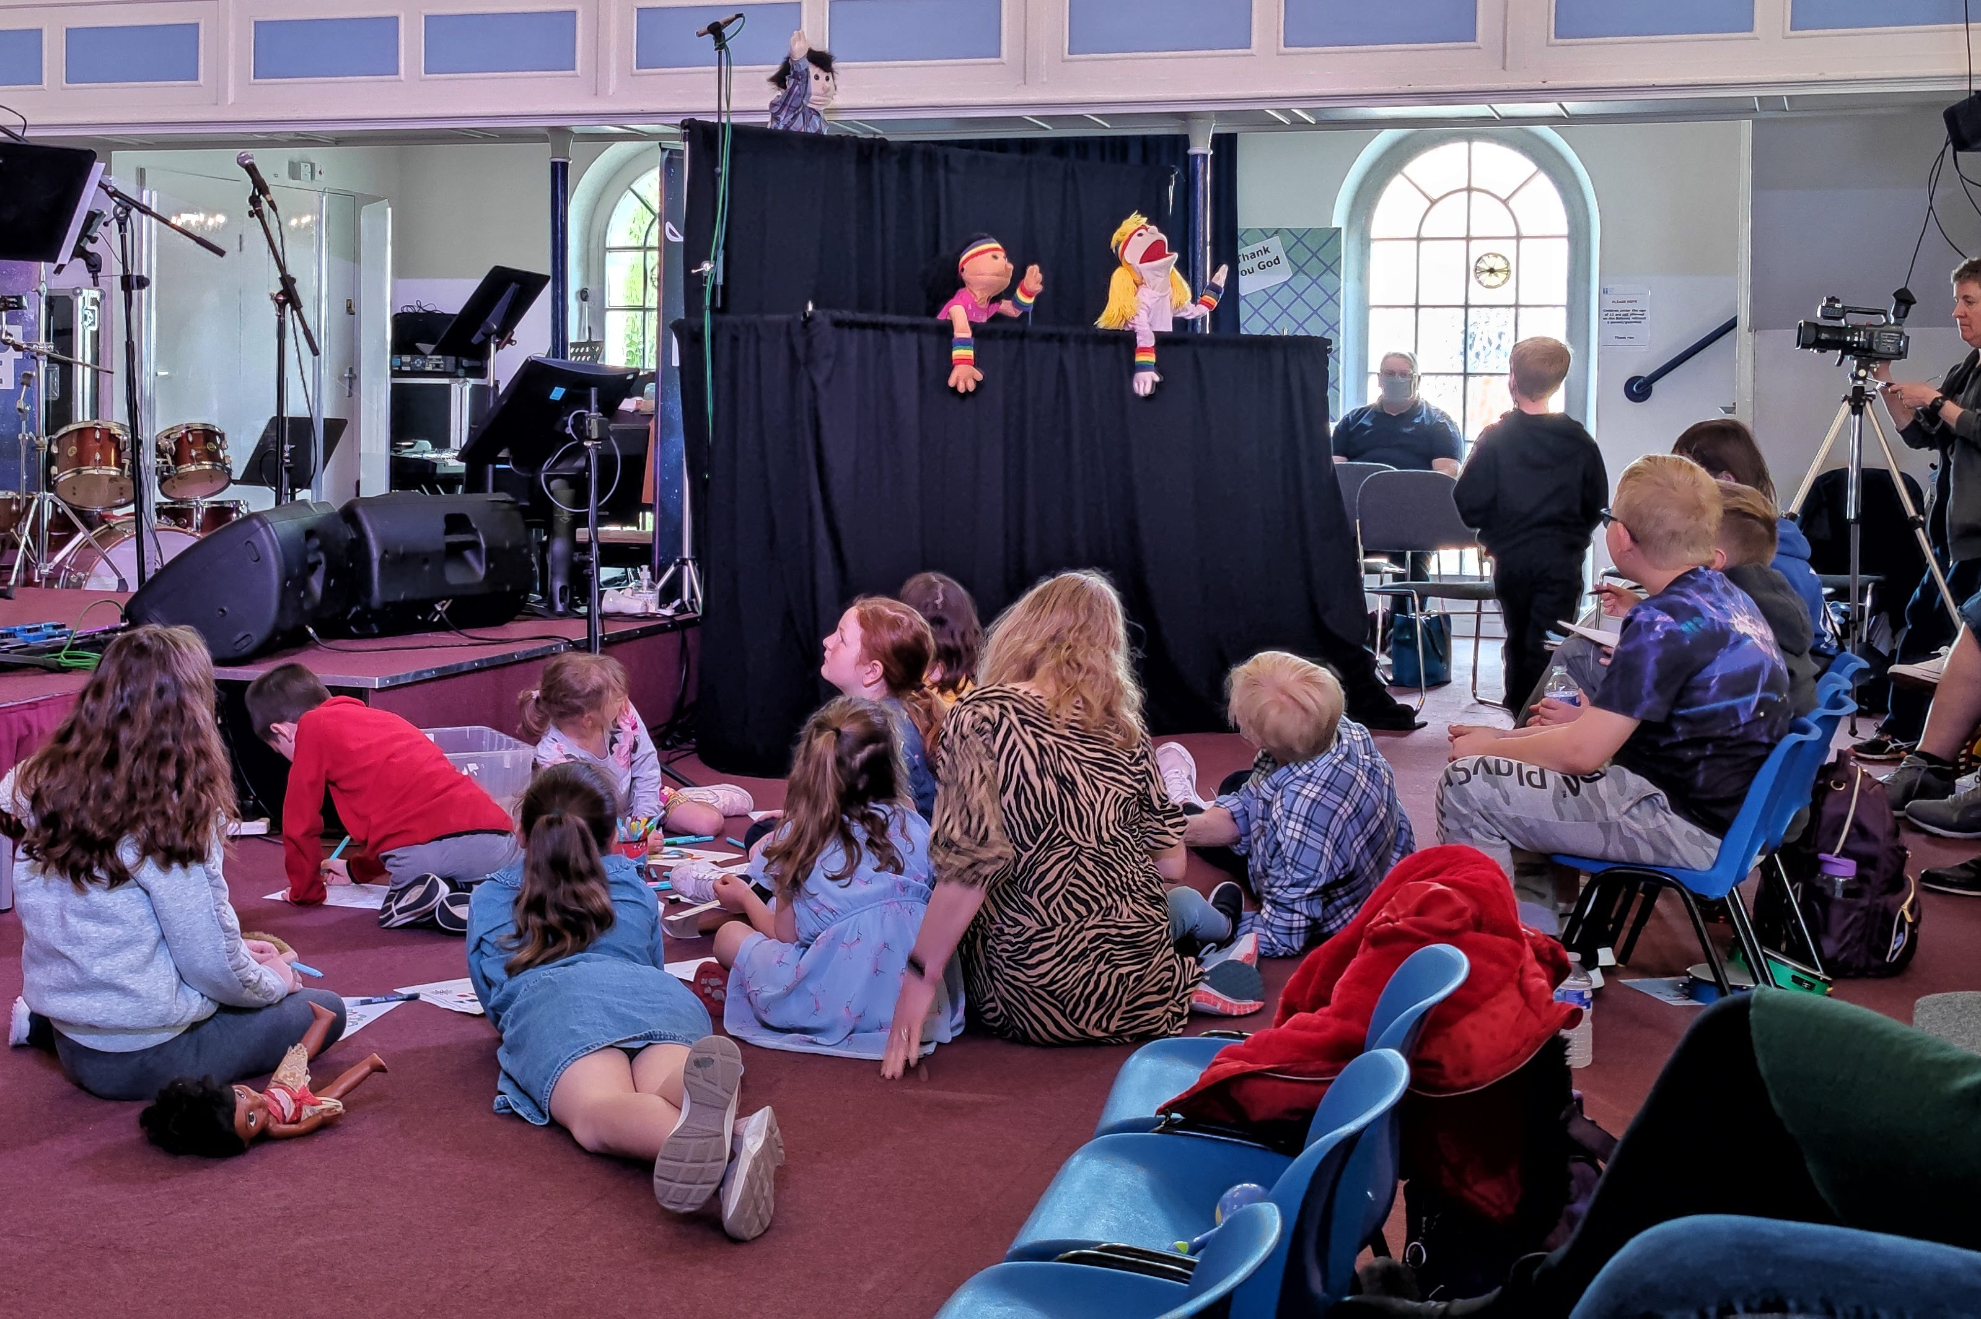
P
Prayer Focus: Rayleigh Baptist Church
Pray for the continued inter-generational focus of the church reaching out to all ages.
For the sense of rebuilding, refreshing and re-establishment after lockdown.
For stability after a season of change.
For the building project and the associated financial challenges this brings.

